Slide 1
Self-Study Action Research Project Workshop
NCE-MSTL
12-13 August 2013

Slide 2
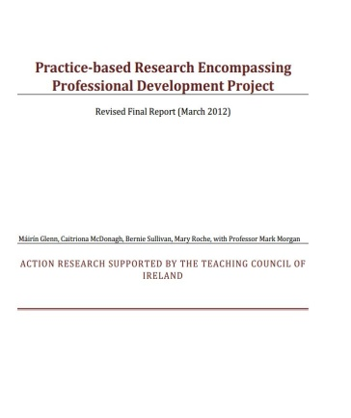
Who we are
Dr. Mary Roche
Dr. Máirín Glenn
Dr. Bernie Sullivan
Dr. Caitriona McDonagh
Our Website
www.eari.ie

Slide 3
Action research for NCE-MSTL
You are required to undertake an action research project in the area of mathematics education during the academic year 2013-2014, and to submit an action research paper documenting your project and your learning throughout the process.

Slide 4
Aims of session
To revisit the basic principles of action research
To explore practical examples of action research
To begin the process of planning and organising your project
To develop practical ideas for writing up your research report (See Handouts)

Slide 5
Action Research
As Reason and Bradbury (2001: 2) explain, “the primary purpose of action research is to produce practical knowledge that is useful to people in the everyday conduct of their lives.
Action research is about working towards practical outcomes, and also about creating new forms of understanding, since action without understanding is blind, just as theory without action is meaningless.”
(cited in Koshy 2005 p 9)

Slide 6
Introduction
Based on Handout
DEVELOPING PRACTICAL IDEAS FOR WRITING UP YOUR RESEARCH REPORT
’
Section 1

Slide 7
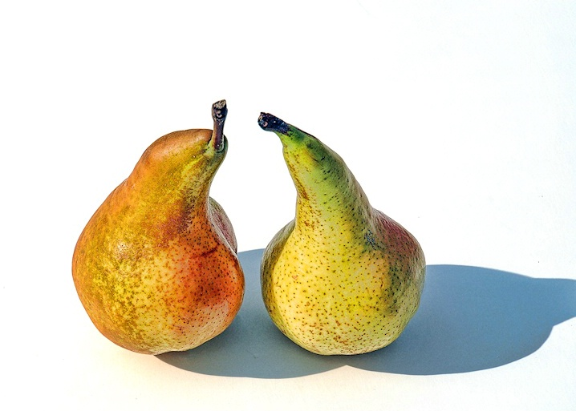
To get started 2 min activity
Ask yourself: Can I name one thing that is really important to me in my teaching of Maths?
What do I care passionately about?
What kind of difference do I want to make in my Maths teaching?
Discuss your ideas with your neighbour. You may write your answers on your Developing Practical Ideas sheet.

Slide 8
The action/reflection process
What issue am I interested in researching?
Why do I want to research this issue?
What kind of data can I gather to show why I am interested in this issue?
What can I do? What will I do?
What kind of evidence can I generate to show that I am having an influence?
How can I explain that influence?
How can I ensure that any judgements I might make are reasonably fair and accurate?
How will I change my practice in the light of my evaluation?
(based on McNiff and Whitehead 2011)

Slide 9
Values
Think of a lesson that went well for you in the last year or so.
Why was this important to you?
Share your ideas in pairs.
Think of one word to explain it.

Slide 10
Values
Watch more interviews with Jack at:
https://www.youtube.com/playlist?list=PL518236EB3DB15C17
https://www.youtube.com/watch?v=1DqKqGDm-G4&list=PL518236EB3DB15C17&index=8

